Slide 1
Data Analysis

Slide 2



Presenters
Abhijit Nelli
15
45/45
Jash Patel
15
45/45
Mohit Jain
15
45/45
NEXT

Slide 3
Today, we're going on an adventure to explore the world of Pokémon.
Pokémon = Pocket Monsters

Slide 4
To start with Data Collection, Data Cleaning and Understanding the Data

Slide 5
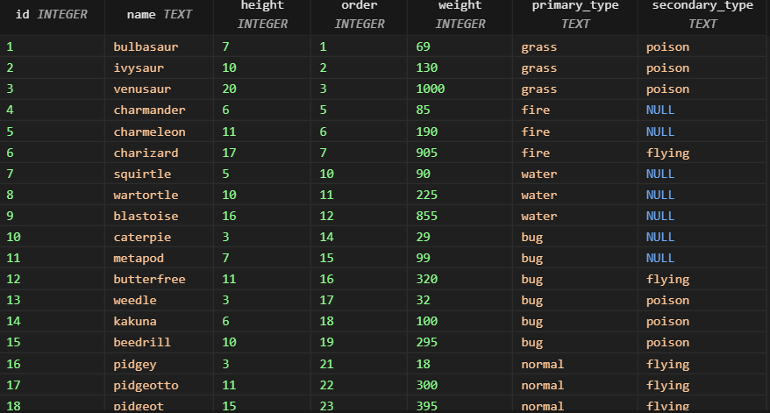
Table 1: Pokédex (pokedex)

Slide 6
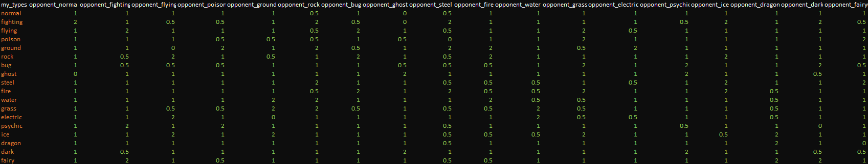
Table 2: Pokémon Advance Types (adv_types)

Slide 7
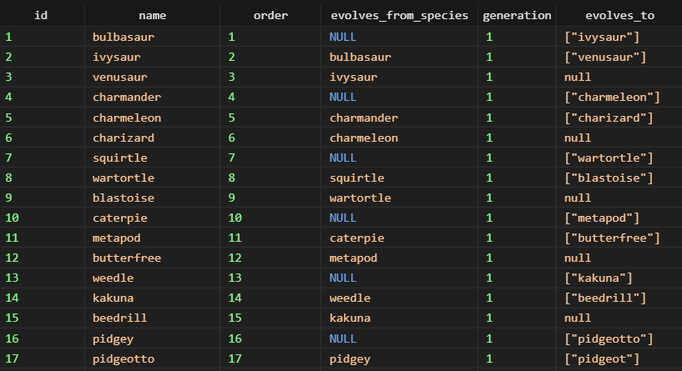
Table 3: Pokémon Evolutions (evolutions)

Slide 8
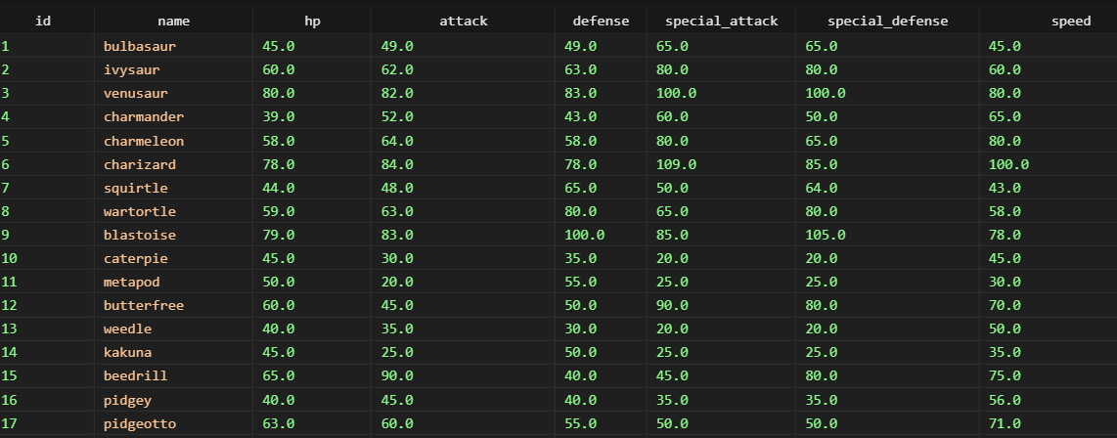
Table 4: Pokémon Base Stats (stats)

Slide 9
Exploratory Data Analysis:

Slide 10
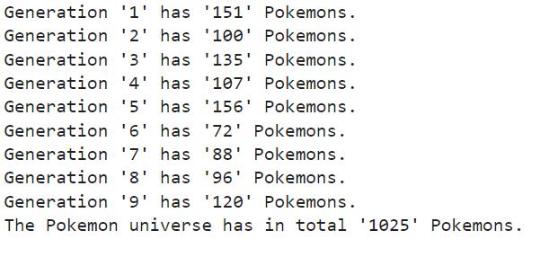
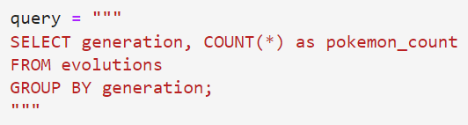
1) How many Pokémons are there in each generation?

Slide 11
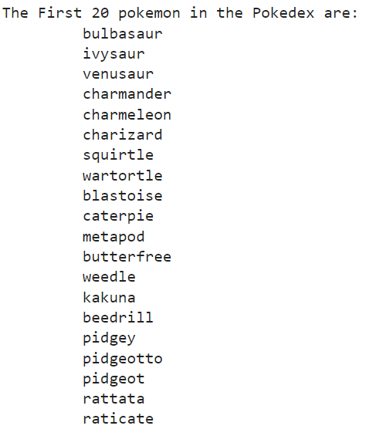
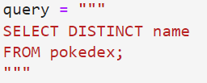
2) What are the different Pokémon species in the Pokédex?

Slide 12
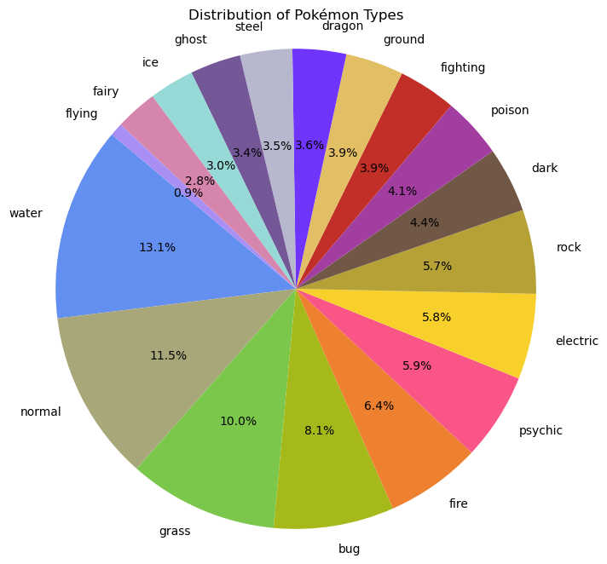
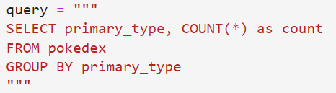
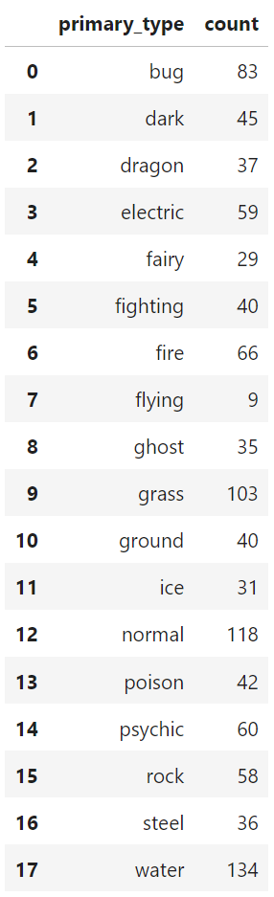
3) What is the distribution of Pokémon types in the Pokédex?

Slide 13
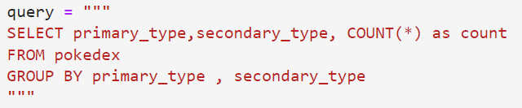
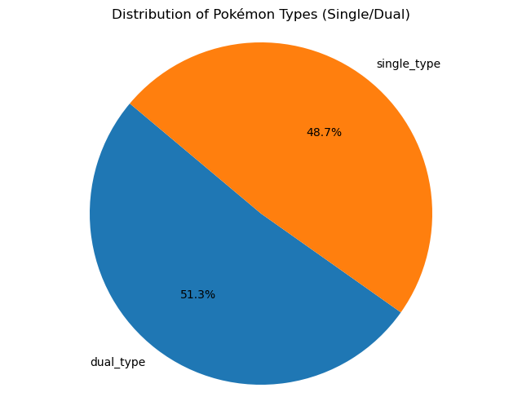
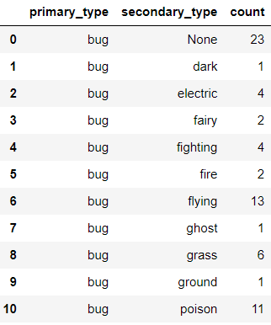
4) How is the distribution of Pokémon types(Single/Dual) among all the Pokémons?

Slide 14
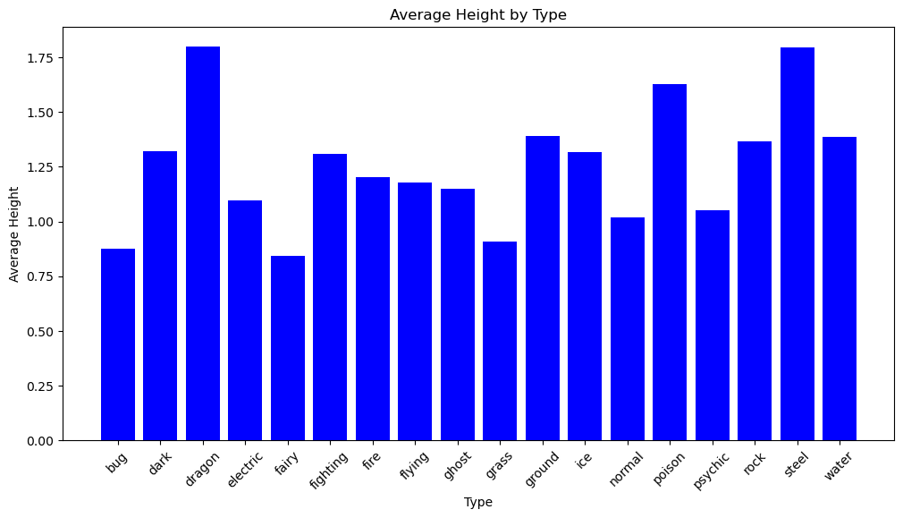
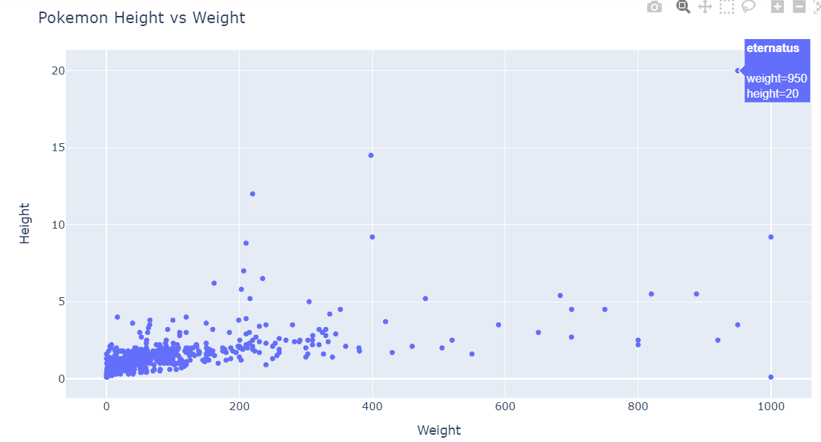
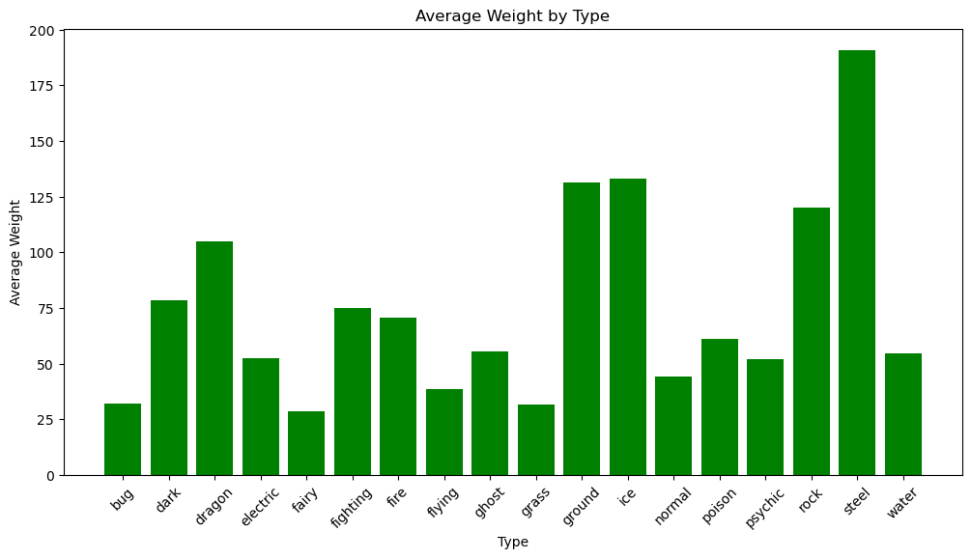
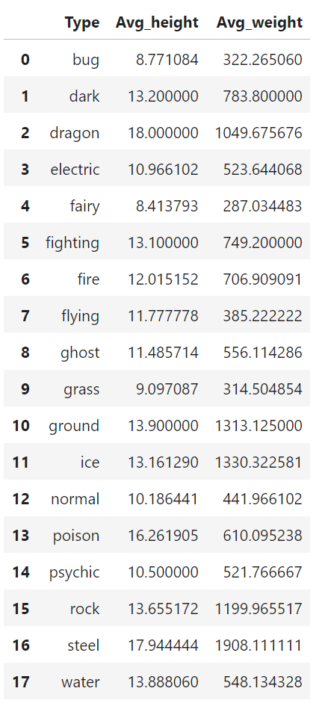
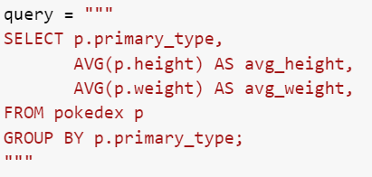
5) How does the height and weight of Pokémons vary across different types?
5) How does the height and weight vary for Each Pokémon?

Slide 15

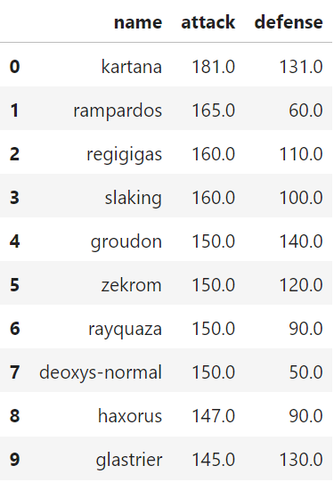
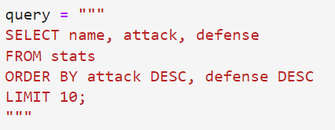


6) Which Pokémon have the highest attack and defense?

Slide 16
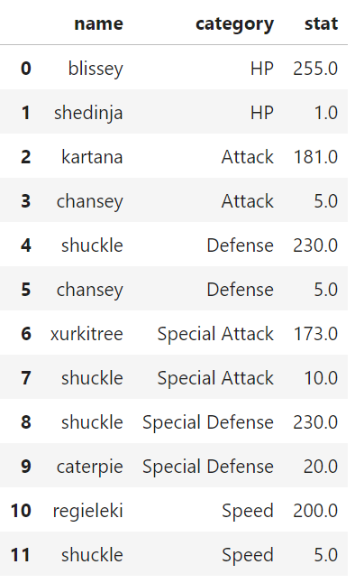
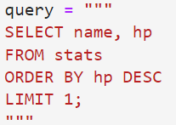
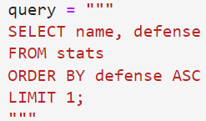
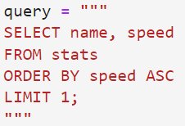
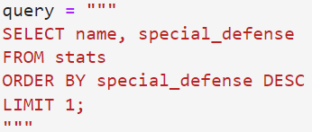
7) Which Pokémon have the highest and lowest base stats (HP, Attack, Defense, Special Attack, Special Defense, Speed)?

Slide 17
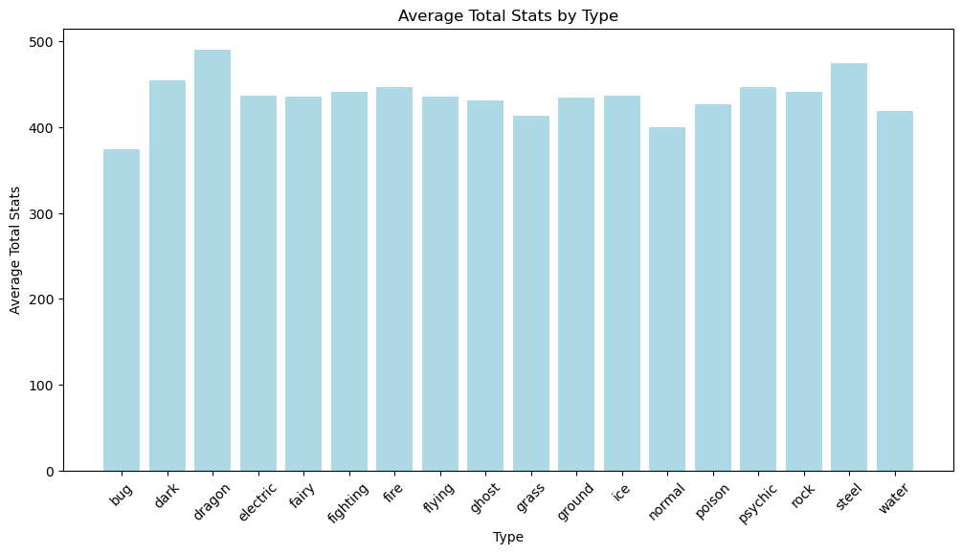
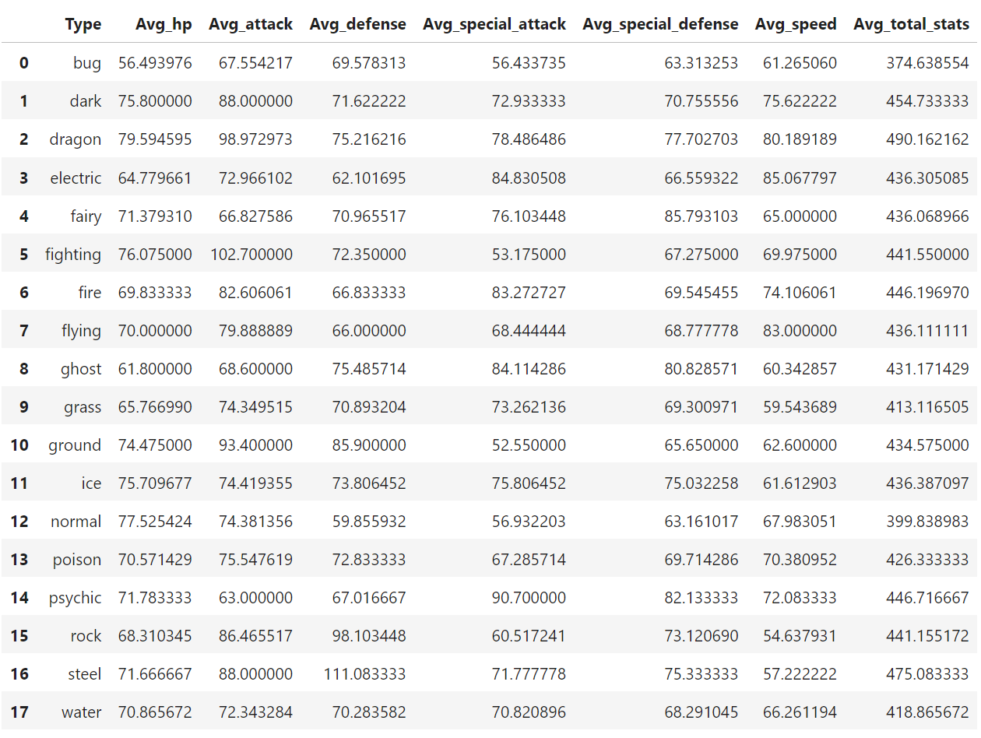
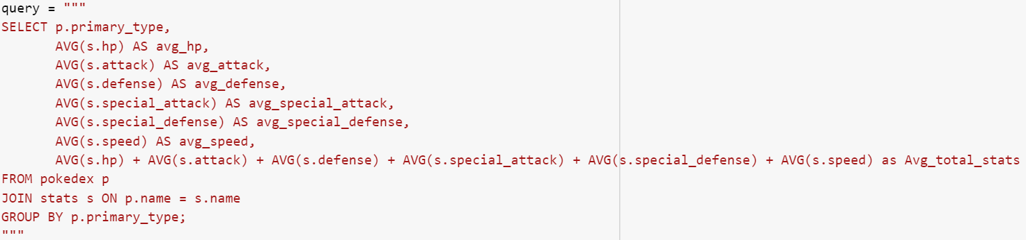
8) How does the base stats of Pokémons look across different types?

Slide 18
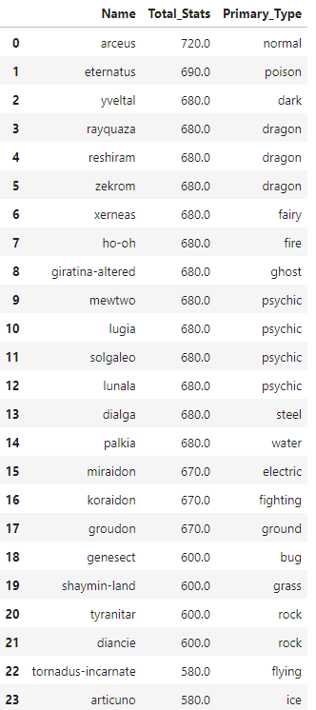
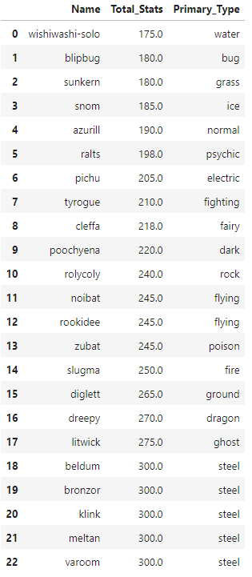
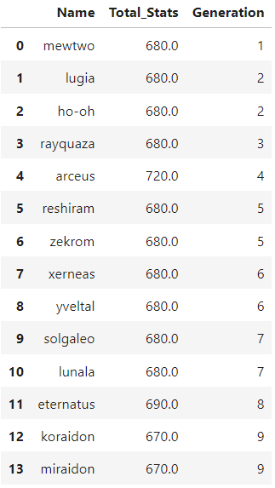
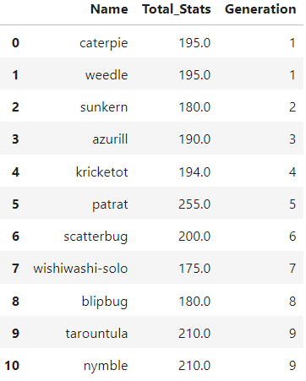
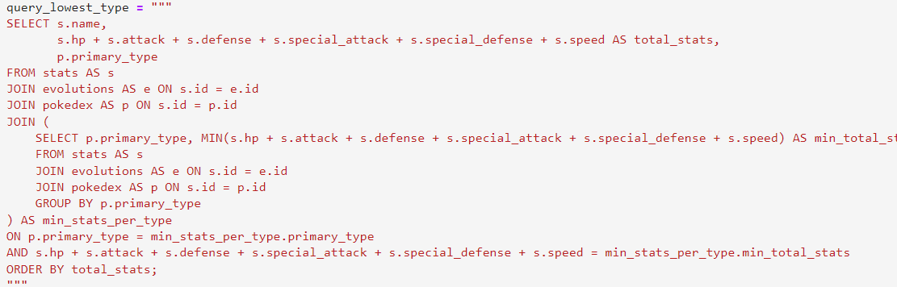
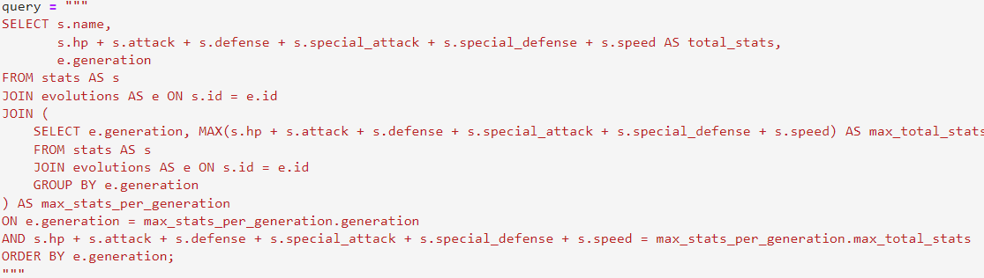
9) Which Pokémon have the highest and lowest total stats (HP, Attack, Defense, Special Attack, Special Defense, Speed) by Generation and Type?

Slide 19
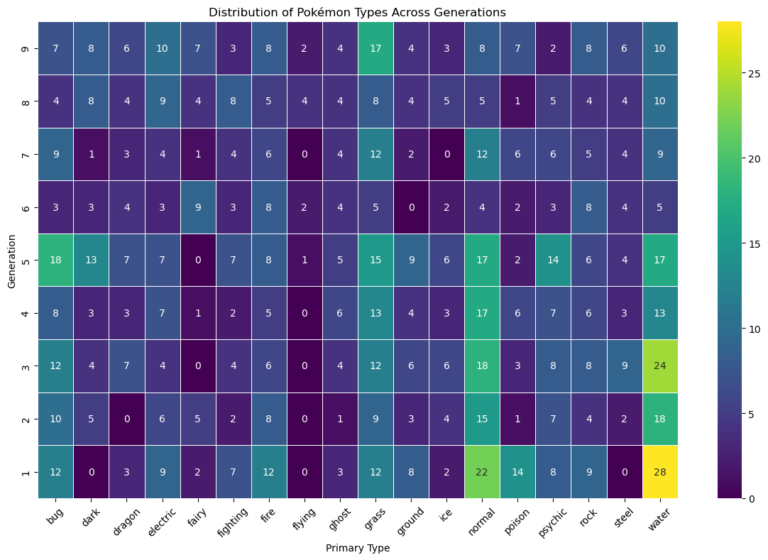
10) How does the distribution of Pokémon types vary across different generations, considering both primary and secondary types?

Slide 20
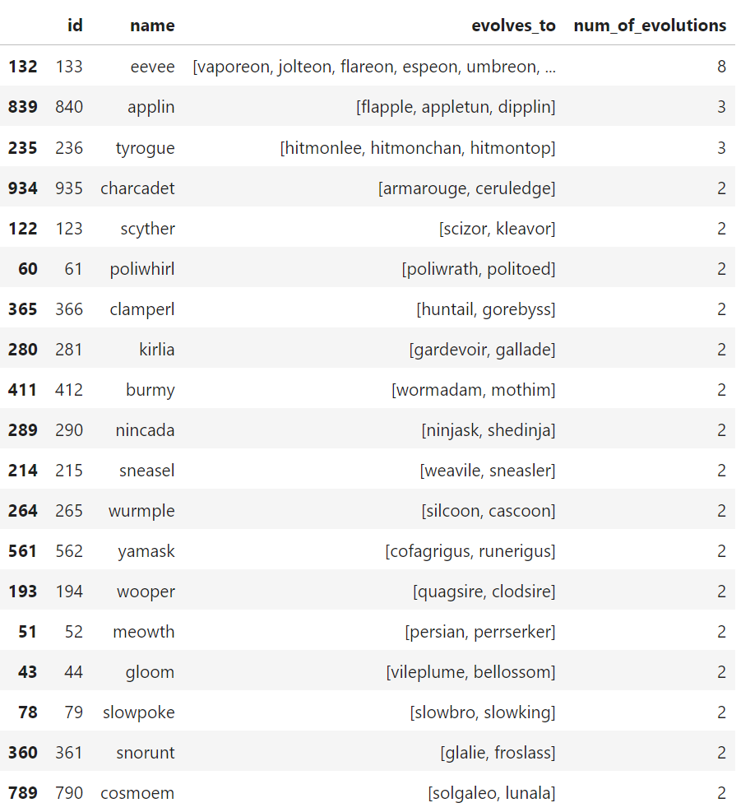
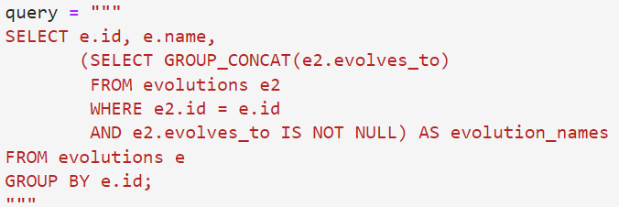
11) How many evolutions exist for each Pokémon, and what are their names?

Slide 21
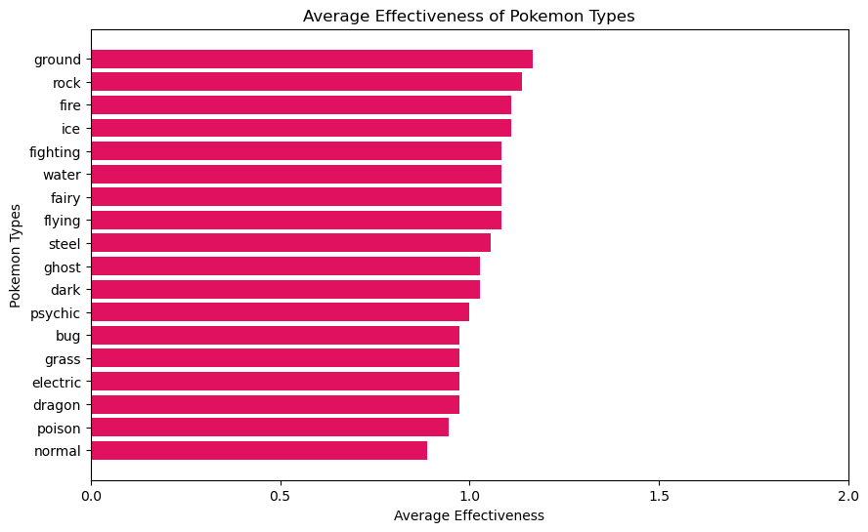
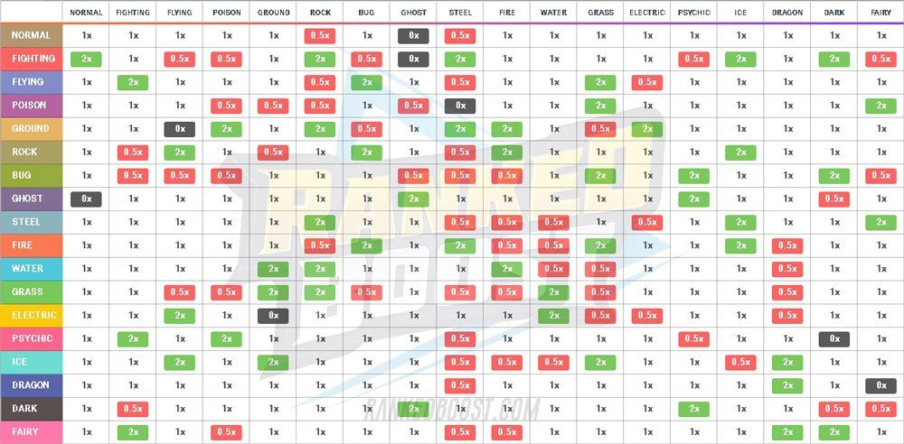
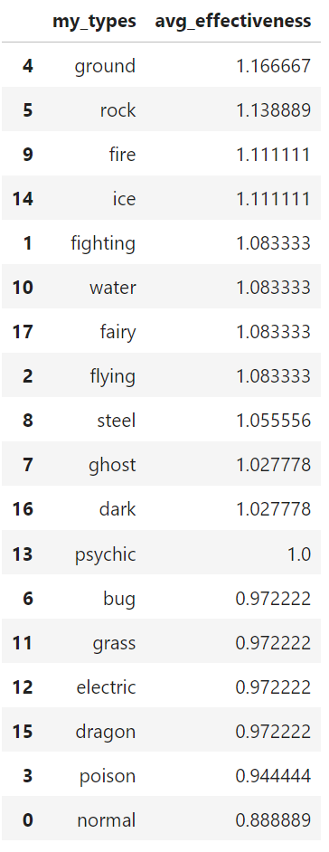
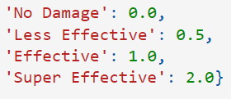
12) How does the type effectiveness look for each Pokémon type?

Slide 22
Pokémon Team Suggestion:

Slide 23
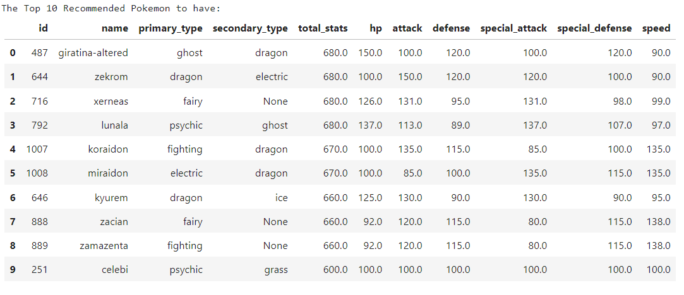
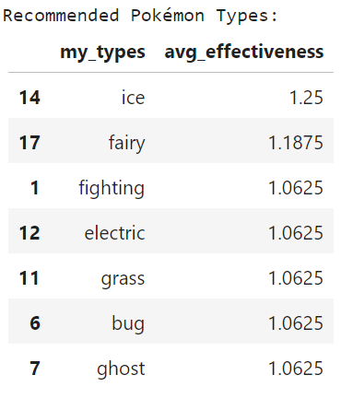
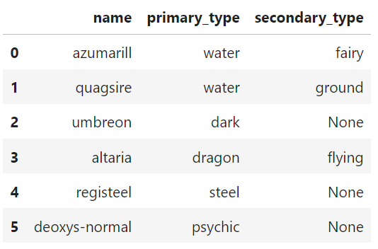
World Champions’ Opponent’s Team
from World Championship Roster

Slide 24
Thank You
Gotta Catch ‘Em All!

